Slide 1

Decognize: PrescriptionDigitization
Using Knowledge Graphs
Group Members:
Muhammad SherjeelAkhtar(P20-0101) Mahad Ashraf(P20-0563)
Supervisor:
Mr. Muhammad Shoaib Khan

Slide 2
Table of contents
Project Objective
Problem Statement
Architecture Diagram
Structured Use Case Diagram
Activity Diagram
Swimlane Diagram
Layer Diagram
Flow Diagram
Implementation 10.Bus iness Opportunity 11.Project Scope
12.UI Design 13.Ga ntt Chart
2
14.References

Slide 3
1.Project Objective

Slide 4
Project Objective
To reduce error percentage in prescriptions readability.
To create an improved OCR system which could later on deployed on other real-life-domains as well.
To allow user to save and access their prescription data conveniently.
Generate a user-friendly output that provides a clear and organized list of recognized medications with recommended dosages.
Utilize deep learning techniques, including TensorFlow, Keras, and OpenCV, to process and detect characters in illegible handwritten texts.
5

Slide 5
2.Problem Statement

Slide 6
Problem Statement
Problem: Inefficient healthcare data management
for prescriptions.
Challenge: Illegible handwriting , medical jargon and Knowledge Graph
Consequence: Errors in healthcare due to traditional OCR systems.
Goal: Develop NLP-based system for accurate
prescription transcription
5

Slide 7
3. Architecture Design

Slide 8
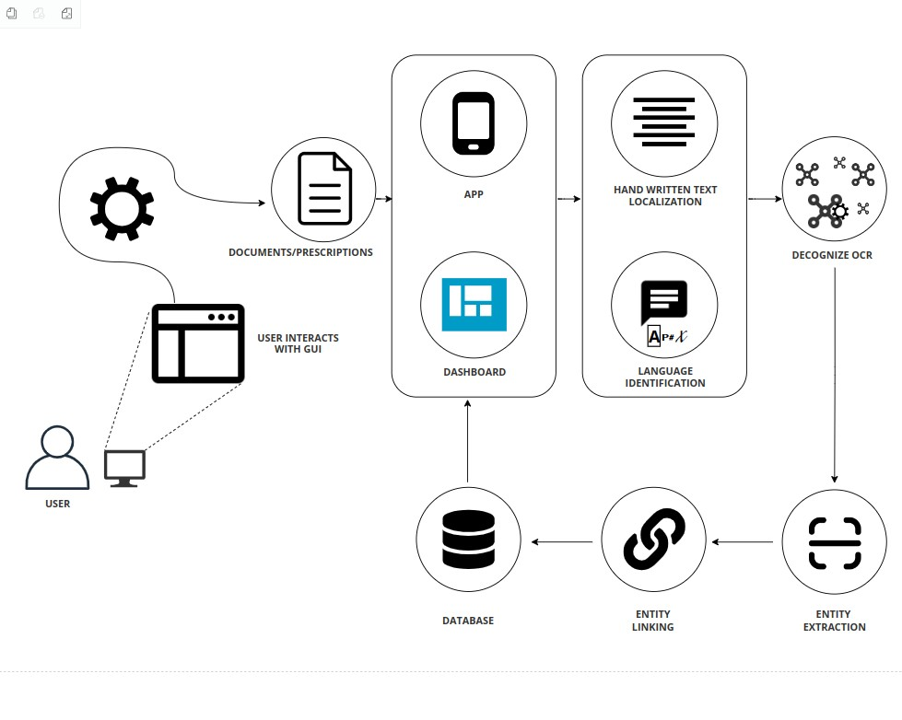

System Diagram
Figure1: Architecture Diagram of DeCognize
6

Slide 9
4. Activ ity Diagram

Slide 10
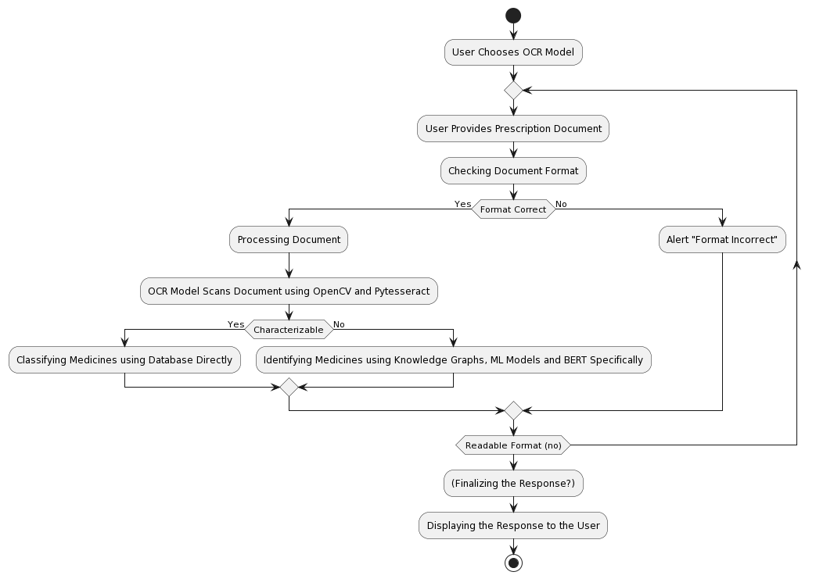
Activity Diagram
Figure3: Activity Diagram of DeCognize
8

Slide 11
5. Swimlane Diagram

Slide 12
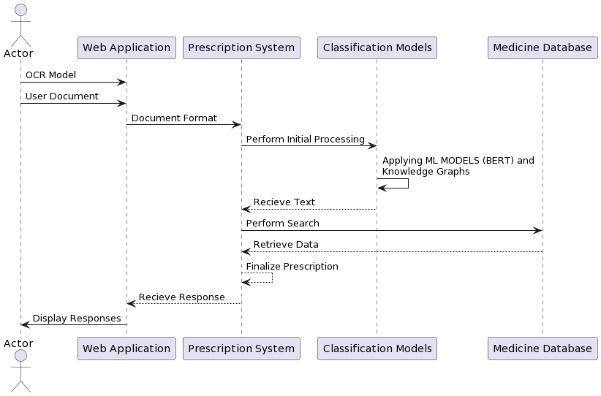
Swimlane Diagram
Figure3: Swimlane Diagram of DeCognize
8

Slide 13
6. Layered Diagram

Slide 14
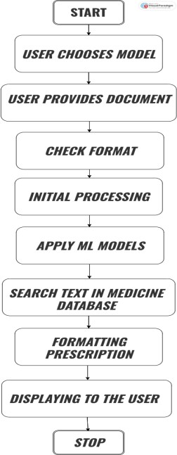
Layered Diagram
Figure3: Layered Diagram of DeCognize
8

Slide 15
7. Flow Diagram

Slide 16
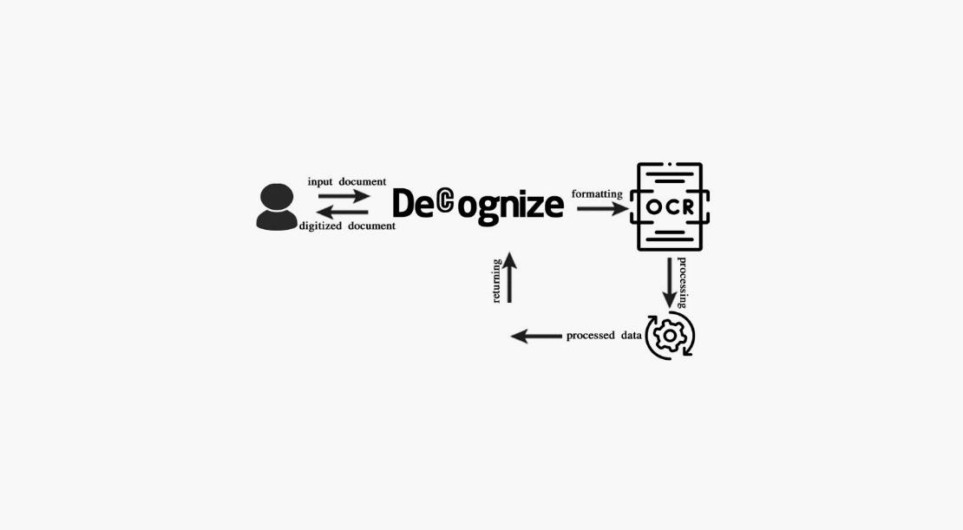
Flow Diagram
Figure3: Flow Diagram of DeCognize
8

Slide 17
8. Use Case Diagram

Slide 18
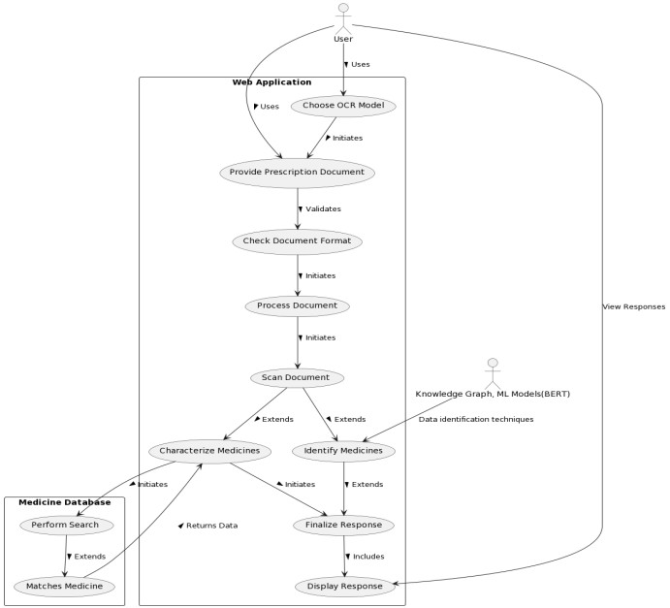
Structured UseCaseDiagram
Figure2: Structured Use Case Diagram of DeCognize
7

Slide 19
9. Implementation

Slide 20
Implementation Code
import cv2
import pytesseract
# Use pytesseract to get bounding boxes
boxes = pytesseract.image_to_boxes(img_rgb, config=custom_config)
pytesseract.pytesseract.tesseract_cmd = r"C:\Program Files\Tesseract- OCR\tesseract.exe"
# Draw bounding boxes on the image for b in boxes.splitlines():
b = b.split()
x, y, w, h = int(b[1]), int(b[2]), int(b[3]), int(b[4])
img_rgb = cv2.rectangle( img_rgb, (x,
img_rgb.shape[0] - y), (w, img_rgb.shape[0] - h), (0,
255, 0), 2)
# Reading image
img = cv2.imread("sample.png")
# Convert to RGB
img_rgb = cv2.cvtColor(img, cv2.COLOR_BGR2RGB)
# Use pytesseract to detect and print text
custom_config = r'--oem 3 --psm 6'
texts = pytesseract.image_to_string(img_rgb, config=custom_config) print("Texts:", texts)
# Show the image with bounding boxes cv2.imshow("Output", img_rgb) cv2.waitKey(0)
cv2.destroyAllWindows()
# Save the text to a file
output_file_path = "output.txt"
with open(output_file_path, "w", encoding="utf-8") as text_file: text_file.write(texts)
print(f"Texts saved to {output_file_path}")
Figure4: Sample Code
10

Slide 21
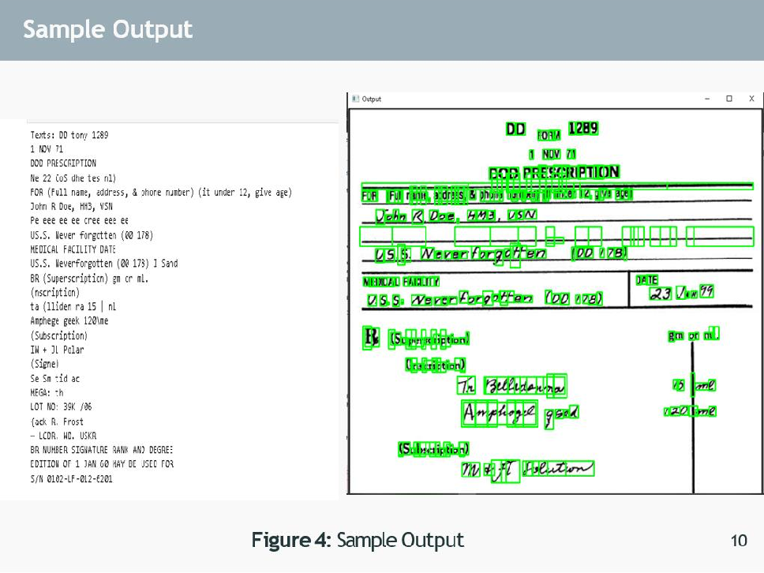

Slide 22

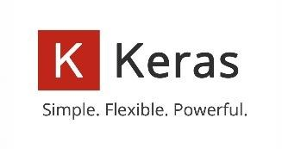




Technologies Used
10

Slide 23
10.Business Opportunity

Slide 24
Business Opportunity
Efficient Data Digitization: Streamline conversion of handwritten medical notes to digital records for time savings and reduced errors.
Enhanced Decision-Making: Improve data accuracy to facilitate quicker, informed healthcare decisions, ultimately enhancing patient care.
Research and Efficiency: Utilize biomedical knowledge graphs to enable advanced research and analytics, driving innovation in the medical field.
4. Cost Savings Automate: Manual data entry, leading to significant operational cost reductions for healthcare institutions.
10

Slide 25
11.Project Scope

Slide 26
Project Scope
Global Market Growth: The global OCR market is experiencing rapid growth, showcasing its significance in addressing diverse industry needs. OCR market was valued at USD 8.93 billion A Compound Annual Growth Rate (CAGR) of 15.4% is anticipated between 2022 and 2030
Recent Projects: Automated doctor prescription by Nano Net Technologies Inc and Neurodata Group.
OCR in Healthcare in Pakistan: Active research by Seerat Rani, Abd Ur Rehman, Beenish Yousaf, Hafiz Tayyab Rauf, Emad Abouel Nasr, and Seifedine Kadry.
Summary: OCR enhancing healthcare in Pakistan through innovation and integration.
10

Slide 27
12. Poster

Slide 28
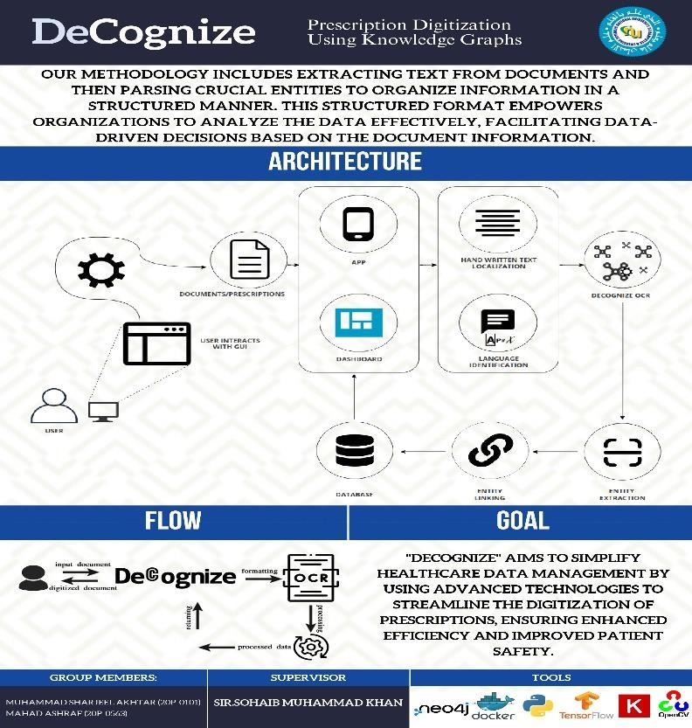

Slide 29
13. UI Design

Slide 30
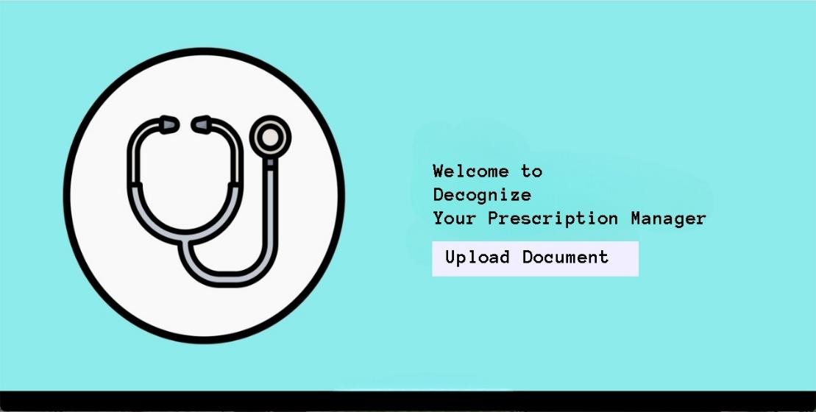

Slide 31
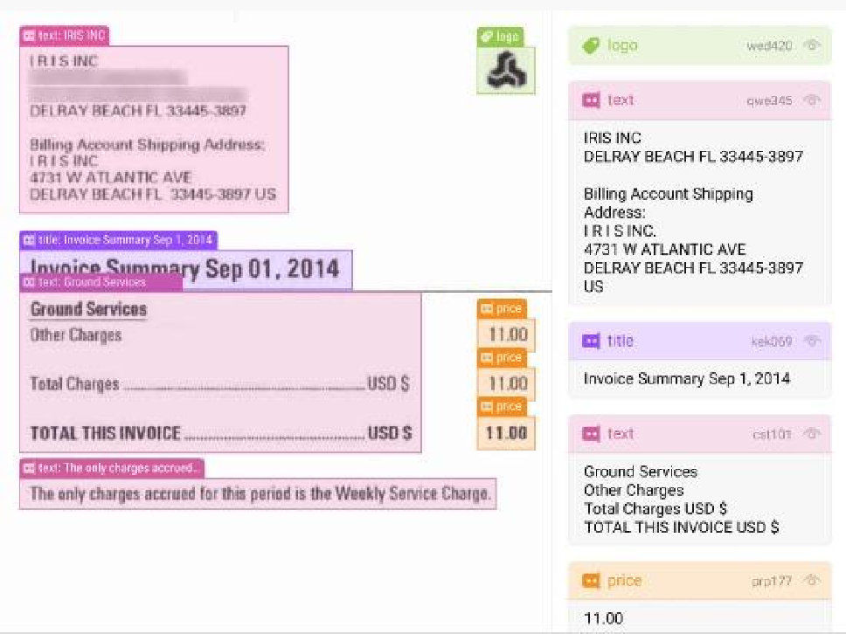

Slide 32
14. Gantt Chart

Slide 33
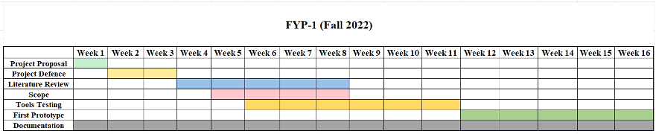
Gantt Chart
FYP-1 :Fall-2023
Figure5: Gantt Chart
11

Slide 34
15. Literature Review

Slide 35
Li | ter | ature Review
Sr. no | Year | Basic Idea | Methodologies | Results | Limitations
[1] | 2023 | OCR with Open CV and tesseract | Implemented Tesseract OCR with Open CV in python. Focusing on image pre-processing for optimal results integrated text detection and recognition components | Achieved satisfactory OCR accuracy with well- preprocessed images. However, Tesseract struggled with complex backgrounds and artifacts, yielding suboptimal outputs. | Tesseracts accuracy is hindered by poor image quality. Requiring meticulous preprocessing . Challenges arise in handling artifacts handwriting and diverse languages .
[2] | 2021 | Optical Character Recognition Using TensorFlow | Implemented OCR with TensorFlow Enhanced model robustness with data augmentation technique. Implemented a custom ResNet architecture for OCR | These results showcase the effectiveness of the OCR model, particularly in accurately recognizing characters within the test set, demonstrating its robustness and suitability for the specified task. | Our Model can fail if the image is complex . E.g cursive writing images or images with Continous Characters Currently our model is trained only on digits and English language
[3] | 2021 | Construct a Bio Medical Knowledge Graph with NLP | Extracted text from biomedical document using OCR and applied BERN and utilized zero relation extractor. | Successfully established a Neo4j knowledge graph, showcasing versatility through demonstrated applications such as search engine, co-occurrence analysis and author expertise inspection. While emphasizing its utility for diverse biomedical machine learning applications. | Limitations include persistent NER challenges with BERN, potential inaccuracie in the zero shot relation extractor and the need for expert validation with external database enrichment reliant on data consistency
[4] | 2018 | Build a Handwritten Text Recognition System using TensorFlow | Implemented HTR using TensorFlow, with NN trained on IAM word- images, including CNN, RNN and CTC layers. Preprocessed data with resizing normalization and potential augmentation. Utilized RMSProp for training and explored enhancements like data augmentation, input size adjustments and decoding strategies. | Implemented successful HTR on IAM word - images, enabling flexible NN customization and identifying ar eas for accuracy improvements. | Limited Diversity due to reliance on IAM dataset Potential recognition errors especially for non-dictionary words CPU based training may be slower : GPU recommended
[5] | 2022 | Doctor Handwritten Prescription recognition system in multilanguage using deep learning | Implemented a system employing machine learning techniques such as CNNs,RNNs,LSTMs for recognizing and translating handwritten prescription notes in diverse language | Successfulrecognition and translation of handwritten prescriptions in various languages. Demonstrated the efficiency of CNNs, RNNs, and LSTMS in multilingual handwritten text processing. | Sensitivity to variations in handwriting styles. Reliance on quality and diversity of training data for optimal performance

Slide 36
References [1]
1. Filip Zelic and Anuj Sable. A review on on OCR with Tesseract
OpenCV
and Python. Nanonets, 2023.
2. Kamlesh Solanki . A review on optical character recognition using tensor flow. Medium, 10:39154–39176, 2021.
3. Tomaz Bratanic , D. Kim et al., “A Neural Named Entity and Multi-Type Normalization Tool for Biomedical
in IEEE Access,Medium vol. 7, pp.
2019, doi: 10.1109/ACCESS.2019.2920708. , 2021
Recognition Text Mining,” 73729–73740,
12

Slide 37
References [3]
Harald Scheidl. Article on Build handwritten text recognition using tensorflow. Medium, 9:87643–87662, 2018.
Kamalanaban, E., M. Gopinath, and S. Premkumar. "Medicine box: Doctor’s
prescription recognition using deep machine learning." International Journal of Engineering and Technology (UAE) 7 (2018): 114-117.
Sandhya , P., and K. P. Rama Prabha. "Compa rison Of Various Machine Learning
Algorithms For Recognizing Text On The Medical Prescriptions." Journal of Pharmaceutical Negative Results (2022): 2083-2091.
14

Slide 38
References [2]
Tabassum, Shaira, Nuren Abedin, Md Mahmudur Rahman, Md Moshiur Rahman, Mostafa Taufiq Ahmed, Rafiqul Islam, and Ashir Ahmed. "An online cursive handwritten medical words recognition s ys tem for busy doctors in developing countries for ensuring efficient healthcare servi ce deli very." Scientific reports 12,
no. 1 (2022): 1-13
Hassan, Esraa, Habiba Tarek, Mai Hazem, Shaza Bahnacy, Lobna Shaheen, and Walaa H. Elashmwai. "Medical prescription recognition using machine learning." In 2021 IEEE 11th Annual Computing and Communi cation Workshop and Conference (CCWC), pp. 0973-0979. IEEE, 2021.
Wijewardena, W. R. A. D. "Medical Prescription Identification Solution." PhD diss., 2021
13

